Slide 1

BASIC PRINCIPLES
DIGITAL SYSTEM DESIGN

Slide 2
20XC14 DIGITAL SYSTEM DESIGN 3 2 0 4
INTRODUCTION: Basic principles of System Design -Building blocks for Computer Systems; CPU, Storage, I/O, Multimedia devices - Functional components of a computer system- Workstations, Servers - Interaction among functional components. (4)
NUMBER REPRESENTATION: Binary - Octal - Hexadecimal - BCD - excess three - Gray codes - Error correcting and detecting codes - Representation of signed numbers – arithmetic operation on signed numbers - Alphanumeric data representation. (5)
BOOLEAN ALGEBRA AND LOGIC GATES: Boolean relations - Laws and theorems - AND, OR, NOT, NAND and NOR gates - exclusive OR gates - Positive and negative logic systems - Simplifications - Karnaugh maps and simplifications - Don’t care conditions - NAND-NAND realizations-PAL and PLA Logics (8)

Slide 3
20XC14 DIGITAL SYSTEM DESIGN 3 2 0 4
DESIGN OF ARITHMETIC AND LOGIC UNIT: Combinational logic circuits – Encoder, Decoder, Multiplexer and Demultiplexer -Representation of integer data, Integer adders, Integer multipliers, Design of integer unit- floating point representation of real data-IEEE representation Floating-point adder/subtractor- Floating-point multiplier, Design of Floating point unit- design of ALU (10)
DESIGN OF REGISTERS AND MEMORY UNIT: Flip-flops, Synchronous sequential circuits – Registers and Counters; Memory unit construction – State Machine Design - State machine as a sequential controller; Moore and Mealy state machines; Derivation of state graph and tables; Sequence detector (8)
PROGRAM EXECUTION : Processing of High Level Language Code:- Assembler- Code generation,-Application binary interface-Interpreter - simple compiler - Instruction set architecture of a simple CPU, Micro architecture of CPU, Generation and Execution of machine code- The hardware-software interface -Hardware features influenced by software requirements - Specifications of the performance of a system (10)
Total L:45+30=75

Slide 4
TEXT and REFERENCE BOOKS
TEXT BOOKS:
1. C.H. Roth and L.L.Kinney, “Fundamentals of Logic Design”, Cengage Learning, 2014
2. William Stallings, “Computer Architecture and Organization Designing for Performance”, Pearson Education, 2014.
3. David A. Patterson, John L. Hennessy, “Computer Organization and Design: The Hardware/Software Interface”, Morgan Kaufmann, 2013.
4. C.Hamacher, Z.Vranesic, S.Zaky and N.Manjikian, “Computer Organization and Embedded Systems”, McGraw-Hill, 2012.
5. N. Nisan and S. Schocken, “The Elements of Computing Systems – Building a Modern Computer from First Principles”, The MIT Press, 2005.
REFERENCES:
1. Mano M.M, "Computer System Architecture", Pearson Education, 2017
2. S. Brown, Z Vranesic, “Fundamentals of Digital Logic with VHDL Design”, McGraw-Hill Education, 2009

Slide 5
20XC14 DIGITAL SYSTEM DESIGN

Slide 6
PHYSICAL SYSTEM
Set of interconnected objects or elements that realize some function.
Characterized by
a set of input signals,
a set of output signals,
relation between input and output signals.
TYPE (voltage, force, temperature,position of a switch, etc.), RANGE.

Slide 7
PHYSICAL SYSTEM: chronometer
Input and output Signals
reset, start, stop: position of three push-buttons;
ref: 10 Hz square wave, VL = 0V, VH = 1V;
h: integer between 0 and 23;
m and s: integers between 0 and 59;
t: integer between 0 and 9.
when reset is pushed down, h = m = s = t = 0;
when start is pushed down, the chronometer starts counting; h, m, s and t represent the elapsed time in tenth of seconds;
when stop is pushed down, the chronometer stops counting; h, m, s and t represent the latest elapsed time.

Slide 8
PHYSICAL SYSTEM: control of a boiler
Relation between inputs and outputs
Signals such as pos and temp that can take any value within a continuous (and thus infinite) set of values, are called … ANALOG SIGNALS
Signals such as on off whose values belong to a finite set (in this case a 2-element set), are called … DIGITAL (or DISCRETE) SIGNALS

Slide 9
Systems whose all inputs and outputs are digital signals are called … DIGITAL SYSTEMS.

Slide 10
Why Digital
Advantages
- Reproducibility of information
- Quality of the data
- Flexibility and functionality: easier to store, transmit and manipulate information
- Economy: cheaper device and easier to design

Slide 11
Applications of digital systems
“Digitization” has spread to a wide range of applications, including information (computers), telecommunications, control systems etc.
Digital circuitry replaces many analog systems: – Audio recording: from tape to music CD to MP3 (MPEG Layer 3) player
Image processing: from silver-halide film to digital camera
Telephone switching networks
Control of mechanical system: e.g., “flight-by-wire”

Slide 12

digital circuit in a wireless communication system

Slide 13
digital circuit in a control system

Slide 14
Digital SYSTEM Design
Digital System Design
what does it mean?
What is this course is about?
What really are computers? and how to they work?
Definition of a Computer
An electronic device which is capable of
1. receiving information (data) in a particular form and
2. of performing a sequence of operations in accordance with a predetermined but variable set of procedural instructions (program)
3. to produce a result in the form of information or signals.

Slide 15
Advantages
A digital computer stores data in terms of digits (numbers) and proceeds in discrete steps from one state to the next.
The states of a digital computer typically involve binary digits which may take the form of the presence or absence of magnetic markers in a storage medium , on off switches or relay
In digital computers, even letters, words and whole texts are represented digitally.
Enables:
Better devices: Better sound recorders, cameras, cars, cell phones, medical devices,...
New devices: Video games, PDAs, ...
Known as “embedded systems”
Thousands of new devices every year
Designers needed: Potential career direction

Slide 16
Blocks needed to design a digital computer
1. A way to distinguish between 0’s and 1’s (called Binary digits)
2. A way to store information (Memory)
3. A way to encode Finite state instructions (Boolean functions)

Slide 17


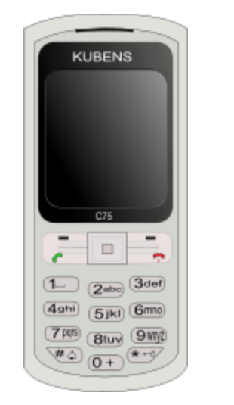
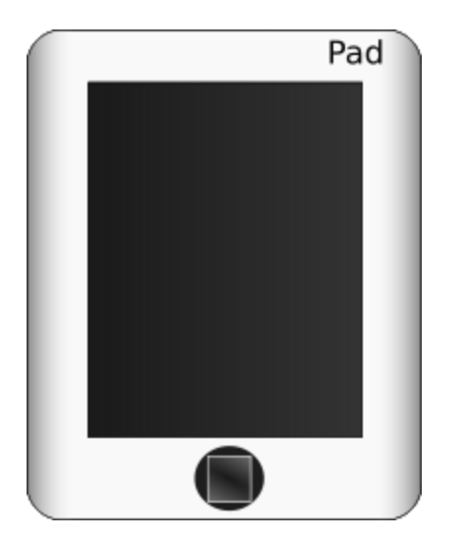
A computer is a general purpose device that can be programmed to process
information, and yield meaningful results.

Slide 18
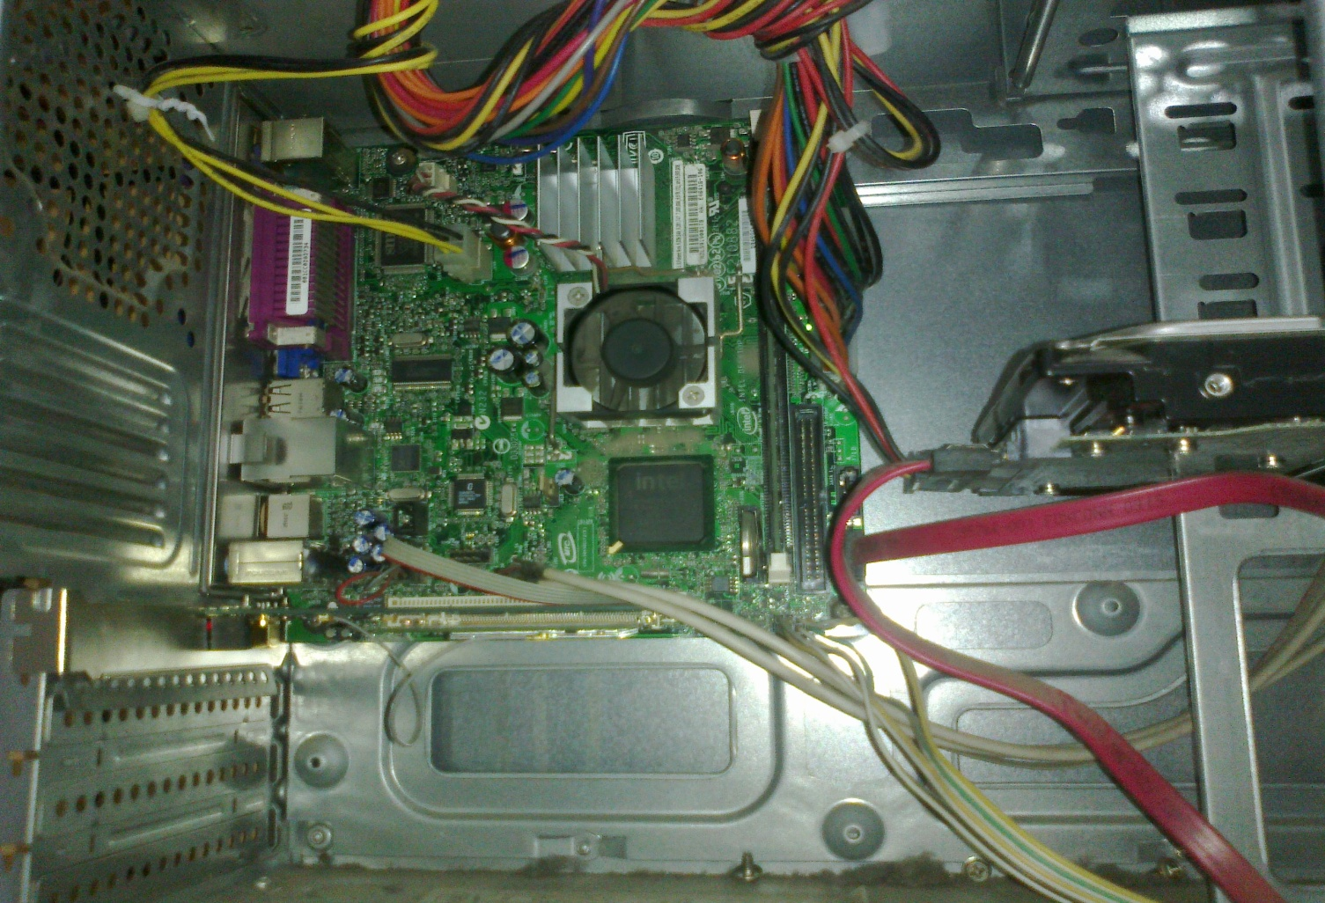
What does a computer look like ?
Let us take the lid off a desktop computer
CPU
Hard disk
Memory

Slide 19
How does it work ?
Information
store
Program
Computer
results
Program – List of instructions given to the computer
Information store – data, images, files, videos
Computer – Process the information store according to the instructions in the program

Slide 20
Let us make it a full system ...
Memory
Hard disk
Computer
Keyboard
Monitor
Mouse
Printer
20

Slide 21
How to Instruct a Computer ?
compile
execute
Program
Executable
Output
Write a program in a high level language – C, C++, Java
Compile it into a format that the computer understands
Execute the program
21

Slide 22
LEVEL OF ABSTRACTION

Slide 23
Software Categories
Operating System
controls all machine activities
provides the user interface to the computer
manages resources such as the CPU and memory
Windows 98, Windows NT, Unix, Linux, Mac OS
Application program
generic term for any other kind of software
word processors, missile control systems, games
Most operating systems and application programs have a graphical user interface (GUI)

Slide 24
What is Computer Architecture? Better (More Detailed) Answer
Application
Operating
System
Compiler
Firmware
Instruction Set
Architecture
Instars. Set Proc.
I/O system
Datapath & Control
Digital Design
Circuit Design
Layout

Slide 25

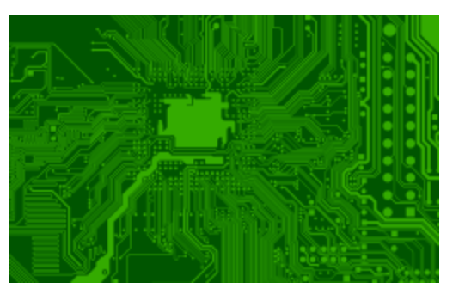
Where are we ...
We have derived the structure of a computer from theoretical fundamentals.
It has a CPU with a program counter & registers, memory, and peripherals.
The Instruction Set Architecture (ISA) is the link between hardware and software.
Instruction
Set
Architecture
25

Slide 26
Features of an ISA
Example of instructions in an ISA
Arithmetic instructions : add, sub, mul, div
Logical instructions : and, or, not
Data transfer/movement instructions
Complete
It should be able to implement all the programs that users may write.
26

Slide 27
Features of an ISA – II
Concise
The instruction set should have a limited size. Typically an ISA contains 32-1000 instructions.
Generic
Instructions should not be too specialized, e.g. add14 (adds a number with 14) instruction is too specialized
Simple
Should not be very complicated.
27

Slide 28
Designing an ISA
Important questions that need to be answered :
How many instructions should we have ?
What should they do ?
How complicated should they be ?
Two different paradigms : RISC and CISC
RISC
(Reduced Instruction Set
Computer)
CISC
(Complex Instruction
Set Computer)
28

Slide 29
Forces on Computer Architecture
Technology
Programming
Languages
Applications
Computer
Architecture
Operating
Systems
History

Slide 30
What Can a Computer Understand ?
Computer can clearly NOT understand instructions of the form
Multiply two matrices
Compute the determinant of a matrix
Find the shortest path between Mumbai and Delhi
They understand :
Add a + b to get c
Multiply a * b to get c
30

Slide 31
The Language of Instructions
Humans can understand
Complicated sentences
English, French, Spanish
Computers can understand
Very simple instructions
The semantics of all the instructions supported by a processor is known
as its instruction set architecture (ISA). This includes the semantics of
the instructions themselves, along with their operands, and interfaces
with peripheral devices.
31

Slide 32
Designing Practical Machines
CPU
ALU
Data
Instruction
Control
memory
memory
I/O devices
Harvard Architecture
32

Slide 33
Machine with Registers
CPU
Registers
ALU
Memory
Control
I/O devices
33

Slide 34
Uses of Registers
A CPU (Processor) contains set of registers (16-64)
These are named storage locations.
Typically values are loaded from memory to registers.
Arithmetic/logical instructions use registers as input operands
Finally, data is stored back into their memory locations.
34

Slide 35
The Five Classic Components of a Computer
Input (mouse, keyboard, …)
Output (display, printer, …)
Memory
main (DRAM), cache (SRAM)
secondary (disk,
CD, DVD, …)
Datapath
Control
Input
Output
Processor
Control
Processor
(CPU)
Memory
1001010010110000
0010100101010001
Datapath
1111011101100110
1001010010110000
1001010010110000
1001010010110000

Slide 36
Our Primary Focus
The processor (CPU)…
datapath
control
…implemented using millions of transistors
…impossible to understand by looking at individual transistors
we need...

Slide 37
DIGITAL FUNDAMENTALS

Slide 38
Analog vs. Digital
There are two basic ways to store and manage data:
Analog
continuous, in direct proportion to the data represented
music on a record album - a needle rides on ridges in the grooves that are directly proportional to the voltage sent to the speaker
Digital
the information is broken down into pieces, and each piece is represented separately
music on a compact disc - the disc stores numbers representing specific voltage levels sampled at various points

Slide 39
What Does “Digital” Mean?
1.2
Analog signal
Infinite possible values
Ex: voltage on a wire created by microphone
Digital signal
Finite possible values
Ex: button pressed on a keypad
1
2
3
4
2
digital
signal
analog
signal
Possible values:
1.00, 1.01, 2.0000009,
... infinite possibilities
Possible values:
0, 1, 2, 3, or 4.
That’s it.
4
value
value
3
2
1
0
time
time

Slide 40
Digital Signals with Only Two Values: Binary
Binary digital signal -- only two possible values
Typically represented as 0 and 1
One binary digit is a bit
We’ll only consider binary digital signals
Binary is popular because
Transistors, the basic digital electric component, operate using two voltages (more in Ch. 2)
Storing/transmitting one of two values is easier than three or more (e.g., loud beep or quiet beep, reflection or no reflection)
value
1
0
time

Slide 41
Example of Digitization Benefit
Analog signal (e.g., audio) may lose quality
Voltage levels not saved/copied/transmitted perfectly
Digitized version enables near-perfect save/cpy/trn.
“Sample” voltage at particular rate, save sample using bit encoding
Voltage levels still not kept perfectly
But we can distinguish 0s from 1s
3
3
Volts
2
2
lengthy transmission
(e.g, cell phone)
1
original signal
1
received signal
0
0
time
time
How fix -- higher, lower, ?
01
10
11
10
11
a2d
Volts
a
digitized signal
lengthy transmission
(e.g, cell phone)
1
1
0
0
time
time
Can fix -- easily distinguish 0s and 1s, restore
Let bit encoding be:
1 V: “01”
2 V: “10”
3 V: “11”
01
10
11
10
11
Digitized signal not
perfect re-creation,
but higher sampling
rate and more bits per
encoding brings closer.
d2a
same
3
Volts
2
1
0
time

Slide 42
How Do We Encode Data as Binary for Our Digital System?
button
a
analog
phenomena
Some inputs inherently binary
Button: not pressed (0), pressed (1)
Some inputs inherently digital
Just need encoding in binary
e.g., multi-button input: encode red=001, blue=010, ...
Some inputs analog
Need analog-to-digital conversion
As done in earlier slide -- sample and encode with bits
0
1
sensors and
r
ed
blue
g
r
een
black
other inputs
electric
digital
0
0
0
signal
data
A2D
r
ed
blue
g
r
een
black
digital
0
0
1
data
Digital System
r
ed
blue
g
r
een
black
digital
digital
0
1
0
data
data
air
33 degrees
D2A
electric
temperature
signal
sensor
actuators and
other outputs
0
0
1
0
0
0
0
1

Slide 43
Digital Information
Computers store all information digitally:
numbers
text
graphics and images
audio
video
program instructions
In some way, all information is digitized - broken down into pieces and represented as numbers

Slide 44
Representing Text Digitally
For example, every character is stored as a number, including spaces, digits, and punctuation
Corresponding upper and lower case letters are separate characters
H i , H e a t h e r .
72 105 44 32 72 101 97 116 104 101 114 46

Slide 45
Binary Numbers
Once information is digitized, it is represented and stored in memory using the binary number system
A single binary digit (0 or 1) is called a bit
Devices that store and move information are cheaper and more reliable if they only have to represent two states
A single bit can represent two possible states, like a light bulb that is either on (1) or off (0)
Combinations of bits are used to store values

Slide 46
Bit Combinations
1 bit
2 bits
3 bits
4 bits
0
1
00
01
10
11
000
001
010
011
100
101
110
111
0000
0001
0010
0011
0100
0101
0110
0111
1000
1001
1010
1011
1100
1101
1110
1111
Each additional bit doubles the number of possible combinations

Slide 47
Bit Combinations
Each combination can represent a particular item
There are 2^{N} combinations of N bits
Therefore, N bits are needed to represent 2^{N} unique items
1 bit ?
2 bits ?
3 bits ?
4 bits ?
5 bits ?
2¹ = 2 items
22 = 4 items
How many
items can be
represented by
23 = 8 items
24 = 16 items
25 = 32 items

Slide 48
A Computer Specification
Consider the following specification for a personal computer:
600 MHz Pentium III Processor
256 MB RAM
16 GB Hard Disk
24x speed CD ROM Drive
17” Multimedia Video Display with 1280 x 1024 resolution
56 KB Modem
What does it all mean?

Slide 49
Memory
9278
9279
9280
9281
9282
9283
9284
9285
9286
Main memory is divided into many memory locations (or cells)
Each memory cell has a numeric address, which uniquely identifies it

Slide 50
Storing Information
9278
9279
9280
9281
9282
9283
9284
9285
9286
Each memory cell stores a set number of bits (usually 8 bits, or one byte)
10011010
Large values are
stored in consecutive
memory locations

Slide 51
Storage Capacity
Every memory device has a storage capacity, indicating the number of bytes it can hold
Capacities are expressed in various units:
Unit Symbol Number of Bytes
kilobyte
megabyte
gigabyte
terabyte
KB 2¹⁰ = 1024
MB 220 (over 1 million)
GB 230 (over 1 billion)
TB 240 (over 1 trillion)

Slide 52
Memory
Main memory is volatile - stored information is lost if the electric power is removed
Secondary memory devices are nonvolatile
Main memory and disks are direct access devices - information can be reached directly
The terms direct access and random access are often used interchangeably
A magnetic tape is a sequential access device since its data is arranged in a linear order - you must get by the intervening data in order to access other information

Slide 53
RAM vs. ROM
RAM - Random Access Memory (direct access)
ROM - Read-Only Memory
The terms RAM and main memory are basically interchangeable
ROM could be a set of memory chips, or a separate device, such as a CD ROM
Both RAM and ROM are random (direct) access devices!
RAM should probably be called Read-Write Memory

Slide 54
The Central Processing Unit
A CPU is also called a microprocessor
It continuously follows the fetch-decode-execute cycle:
Retrieve an instruction from main memory
fetch
execute
decode
Carry out the
instruction
Determine what the
instruction is

Slide 55
The Central Processing Unit (CPU)
The CPU contains:
Arithmetic / Logic Unit
Performs calculations and decisions
Coordinates processing steps
Control Unit
Small storage areas
Registers

Slide 56
The Central Processing Unit
The speed of a CPU is controlled by the system clock
The system clock generates an electronic pulse at regular intervals
The pulses coordinate the activities of the CPU
The speed is measured in megahertz (MHz)

Slide 57
Device Technologies Fabrication of an IC
Transistors and connection are made from many layers (typical 10 to 15 in CMOS) built on top of one another
Each layer has a special pattern defined by a mask
One important aspect of an IC is the length of a smallest transistor that can be fabricated
– It is measured in micron (μm, 10-6 meter) – E.g., we may say an IC is built with 0.50 μm process
– The process continues to improve, as witnessed by Moore’s law
– The state-of-art process approaches less than a fraction of 0.1 μm (known as deep sub-micron)

Slide 58
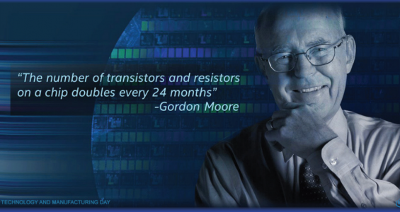

Slide 59
Moore’s law
Transistor geometry
Chips double its density (number of transistor) in every 18 months
Devices become smaller, faster and cheaper
Now a chip consists of hundreds of million gates
And we have a “wireless-PDA-MP3-player-camera-GPS-cell-phone” gadget soon

Slide 60
Chapter Summary
Digital systems surround us
Inside computers
Inside huge variety of other electronic devices (embedded systems)
Digital systems use 0s and 1s
Encoding analog signals to digital can provide many benefits
e.g., audio -- higher-quality storage/transmission, compression, etc.
Encoding integers as 0s and 1s: Binary numbers
Microprocessors (themselves digital) can implement many digital systems easily and inexpensively
But often not good enough -- need custom digital circuits

